Slide 1

How to get insights from Big Data
Dinesh Kumar P,
Product Manager, Syncfusion Software.
“Without data you are just another person with opinion”
- W. Edwards Deming.

Slide 2

Agenda
Where does ‘Big Data' fit in 'Data Science' world?
Big Data – SQL comparison
Data Warehouse and Cloud Burst
Getting insights from Cloud Data Warehouse using Bold BI
Notes:
Big Data - is not actually about technology or Software, its THINKING. That also differs case by case and even among companies.

Slide 3
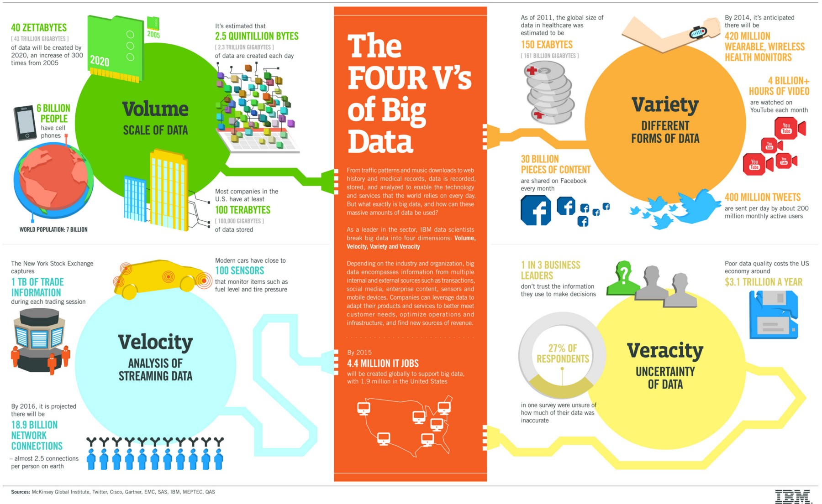
Notes:
Not only for Big Data, can be told for Data science as well.
Velocity will directly impact Volume.
Even though its 1 TB and its velocity is very less, plus the data is of Flat type, then RDBMS itself is a best choice.

Slide 4
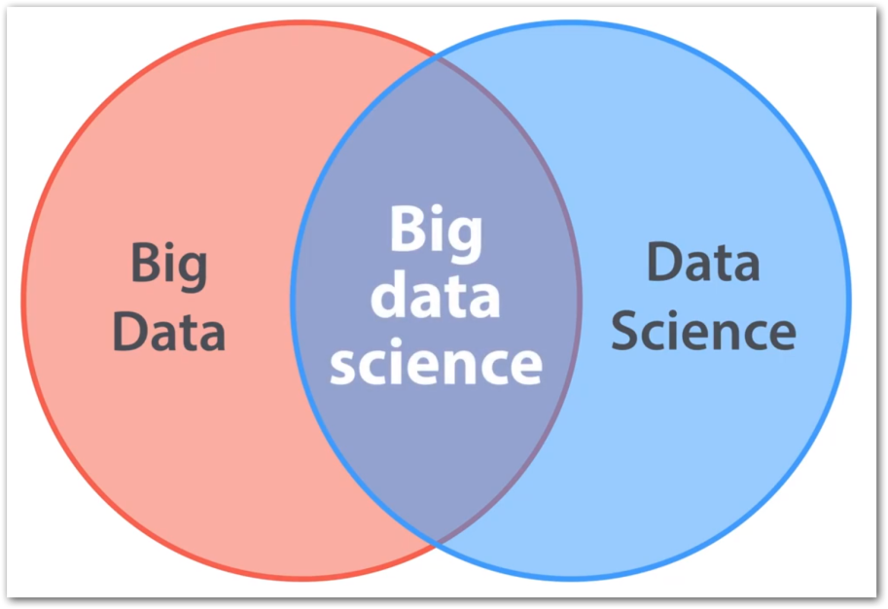
Big Data vs Data Science
Big Data + Data Science = Big Data Science
Big Data ≠ Data Science
Big Data -> All 4 Vs
E.g. Shares trade, E-Shopping
Data Science -> 1 V
E.g. ML use cases like Genetics data, Credit card fraud detection – Volume

Slide 5
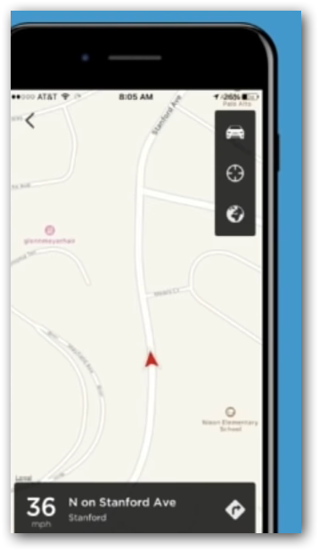
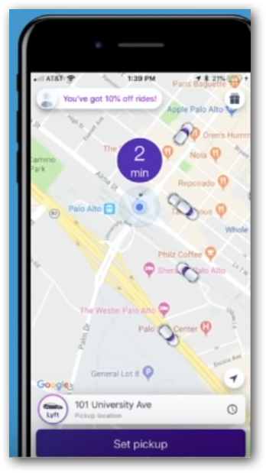
Which one a user would Like?
Where is my driver?
2. When will my driver get here?
Notes:
Data science – With the history of gbs or tbs of trip data, bring up some fact / model that can predict the approximate time
Big Data – Use that model in each and every trip and show the value to user. i.e. Real VALUE that a customer expect.

Slide 6
Which one a user would Like?
Where is my driver?
Just real time.
When will my driver get here?
Real time combined with historical data.
The Business (winning) touch.
Notes:
Data science – With the history of gb’s or tb’s of trip data, bring up some fact / model that can predict the approximate time
Big Data – Use that model in each and every trip and show the value to user. i.e. Real VALUE that a customer expect.

Slide 7

Why Data matters?
For a business to run successfully - not only it is historical data. now a days current data also is necessary.
E.g. Showing Recommendation in e-commerce sites.
Notes:
Cost reduction - Big data technologies such as Hadoop and cloud-based analytics bring significant cost advantages when it comes to storing large amounts of data. (On-premises - Commodity Hardware)

Slide 8
SQL Data
Vertically Scalable.
Increase the load on a single server by increasing things like CPU, RAM or SSD.
Adding more floors to the same building.
Not SQL (Big Data)
Horizontally Scalable.
Can handle more traffic by sharding, adding more servers.
Adding more buildings to the neighborhood.
Notes:
Sharding
Splits large data sets into small data sets across multiple instances.
E.g. Hadoop - distributed cluster architecture.

Slide 9
Why BigData? Hadoop: SQL Comparison
Hadoop | SQL
Schema on Read | Schema on Write
Master Slave | Client Server
Data stored as like the form of file itself (txt, csv, mp3,…) or compressed form (RC, parquet,..) | Stored as logical forms and interrelated columns
Distributed processing across 1000s of nodes. | Not much cluster size at most.
Need to do a lot of effort for quick, real time response that require huge data as well. | Can expect response in milli seconds
E.g. Twitter Hashtag search happen over 1000 servers, ok if miss some tweets due to unavailability of 1 of 60 nodes | E.g. Transaction(Banks), Share market
Notes:
Spark will not suit for 100 MB / 1 GB data
Same way you cannot easily process a semi-structured / un-structured / no-sql data in RDBMS.

Slide 10
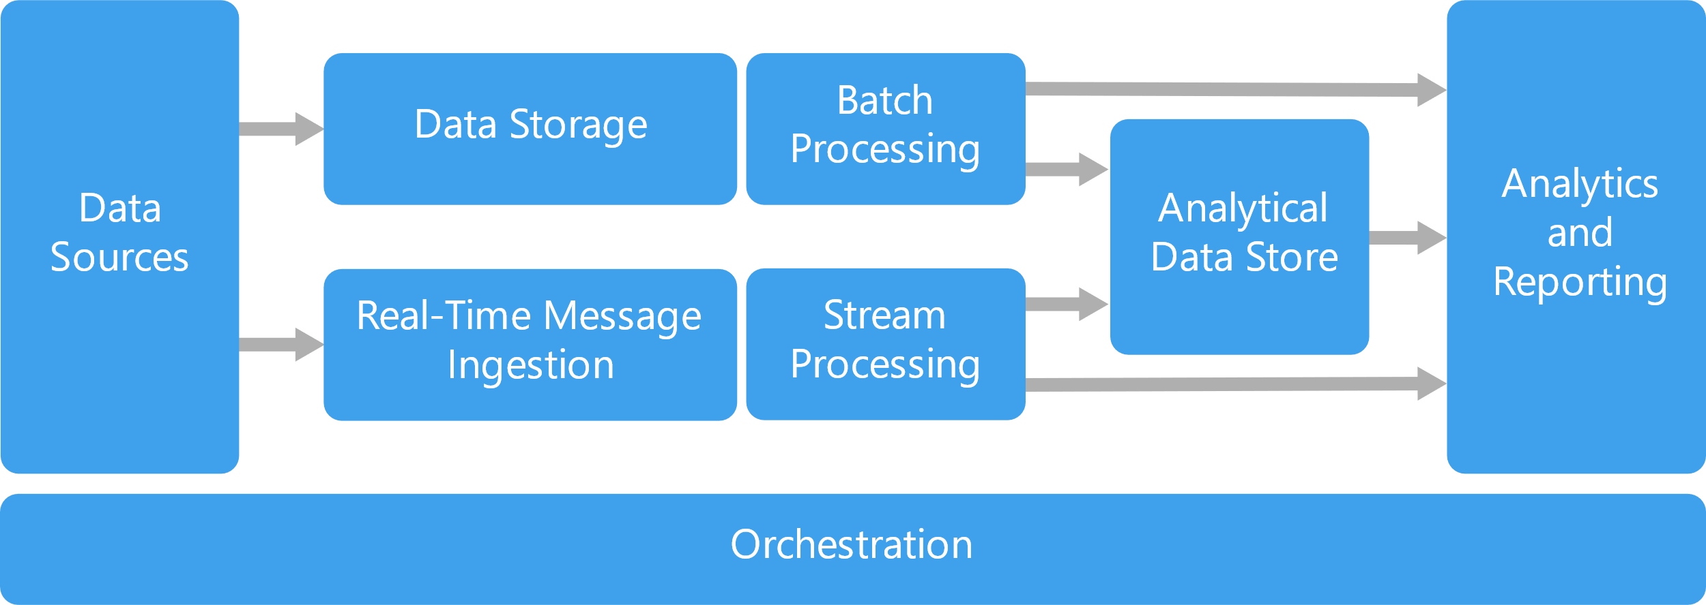

Slide 11
Customer review log files – cloud storage
(Azure Blob / Amazon S3)
Azure Blob
Hadoop, Spark
Microsoft SQL Server
Bold BI
Apache Kafka
Spark Streaming
ML Ops

Slide 12
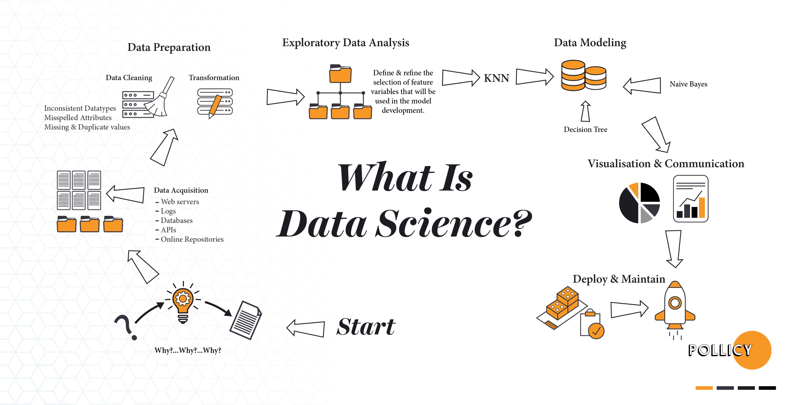

Slide 13
Data engineer’s routine work
2. Identify source(s) of Data
4. Storage & Access
5. Processing
6. Visualization
3. Data Integration
1. Defining Objective

Slide 14

1. Defining Objective
Understand the domain & industry,
Discuss about the business need / problem,
Ask more and more WHYs?
Prepare the objectives.

Slide 15
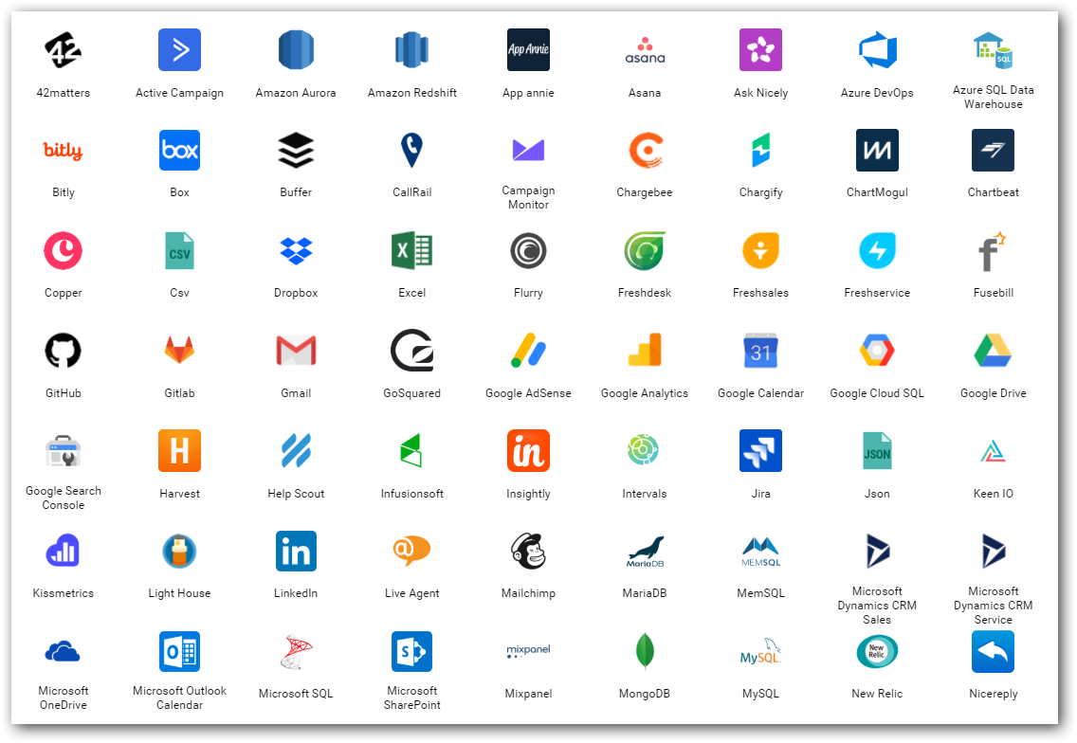
2. Data source(s)
Find out from where you need to get the data for your project.
Either provided or should search and find.
Logs
Databases
Web (REST APIs)
Social Media
…
Notes:
Logs – NASA logs which we gonna process.

Slide 16
3. Data Integration
Required data would exist in different sources those need to be brought to one place for,
Gather
Clean
Prepare
Tools
Apache Sqoop
Informatica
Apache Nifi…

Slide 17
4. Storage & Access
Different stages
Initial
Processing
Final
Instances & Services
Cloud Database instances (SQL Server, MySQL,..)
Amazon S3
Azure Blob / Azure Data Lake…
Access
API
Integration between processing tools

Slide 18
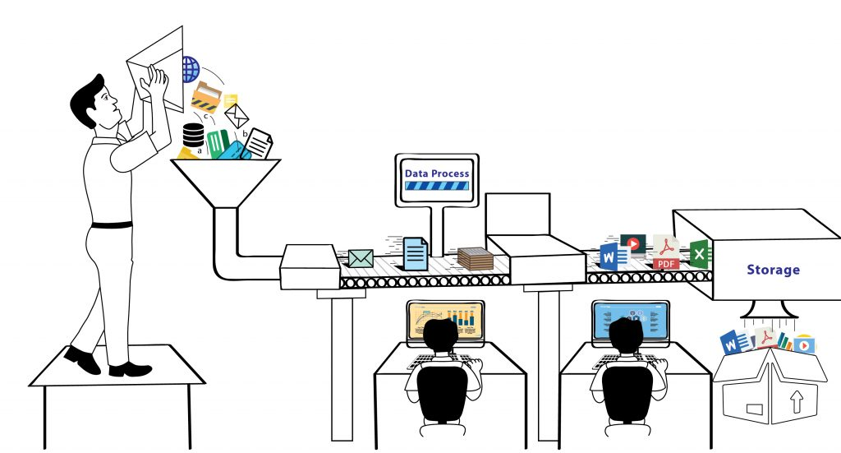
5. Process
Analyze / Do Analytics
ML models
Map Reduce
Tools & Services
Apache Pig / Hive / Spark
Amazon Sage Maker
Azure HDInsight / Databricks / ML Studio

Slide 19
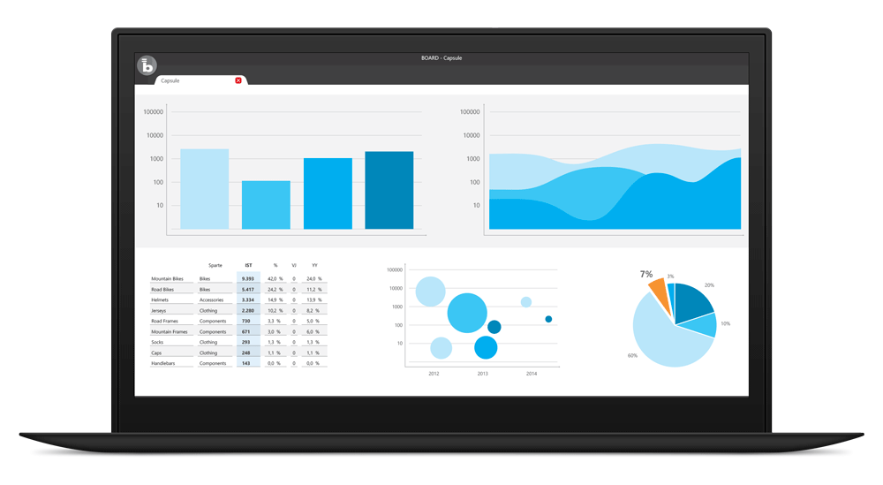
6. Visualize
BI tools for business decisions
Microsoft Power BI
Tableau
Qlik
Bold BI
…
In-built packages in R, Python
Notes:
Most important.
This is how the top cream layer gets the view of their business that leads to decisions.

Slide 20


Importance of Business Intelligence and Visualization
How to convey your boss with data in Excel with thousands of rows?
Just convey it as a bar chart / pie chart.
Transform the data into charts, images,… that explain the numbers and allow us to get insights from it.
Meaning and purpose to the original data.
See the story that lives in your data.
Discover patterns (HISTORY), metrics (CURRENT) and spot trends (FUTURE).

Slide 21
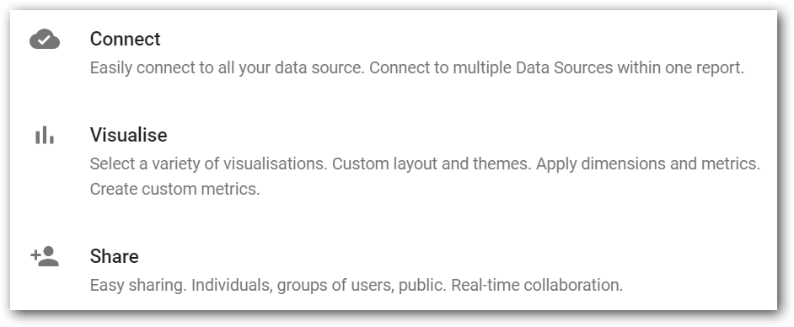

Slide 22
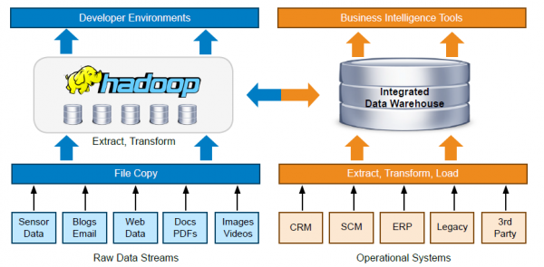
Notes:
A typical tool set and workflow architecture of a Data team

Slide 23
Big Data Hype
Companies were selling Big Data solutions as a silver bullet solution to all the enterprises’ problems.
For a use case using Hive+Oozie didn’t provided expected result. Butworked better with MySQL+Cron.
There was no ideal approach like below;
Client - “I want to implement a Big Data solution”
Consultant- “That could be the solution, but let us discuss the problem first”.
Notes:
My opinion - Ecosystem projects are not growing to be compatible with Hadoop. E.g. Pig, Sqoop, Oozie,…

Slide 24
Cloud services
Storage – HDFS –> Azure Data Lake...
Processing – Map Reduce –> Azure Kubernetes cluster, Azure Synapse Analytics, Azure Databricks...
Resources elasticity -> Create as you go via Automation scripts (Powershell, Ansible). That too Synapse take care of resource computation by itself “server as service”.

Slide 25
Cloud Burst
Allowed to be conservative in investments.
Crawl before you walk and walk before you run.
Elasticity both for Storage and Processing.

Slide 27
Resources
Notes:
My opinion - Ecosystem projects are not growing to be compatible with Hadoop. E.g. Pig, Sqoop, Oozie,…

Slide 28
Thank you! Questions ?

